Slide 1
Ng, Xian Kai
Presents

Slide 2
Story
Mr. Ball Peggert is doing Machine Learning research
Woah Machine Learning!!!
100petaFLOPS but hours of waiting
Use TIME and STRACE
I/O bound!?
RAM bandwidth sucks

Slide 3
Banshee
Enter

Slide 4

Banshee?

Slide 5
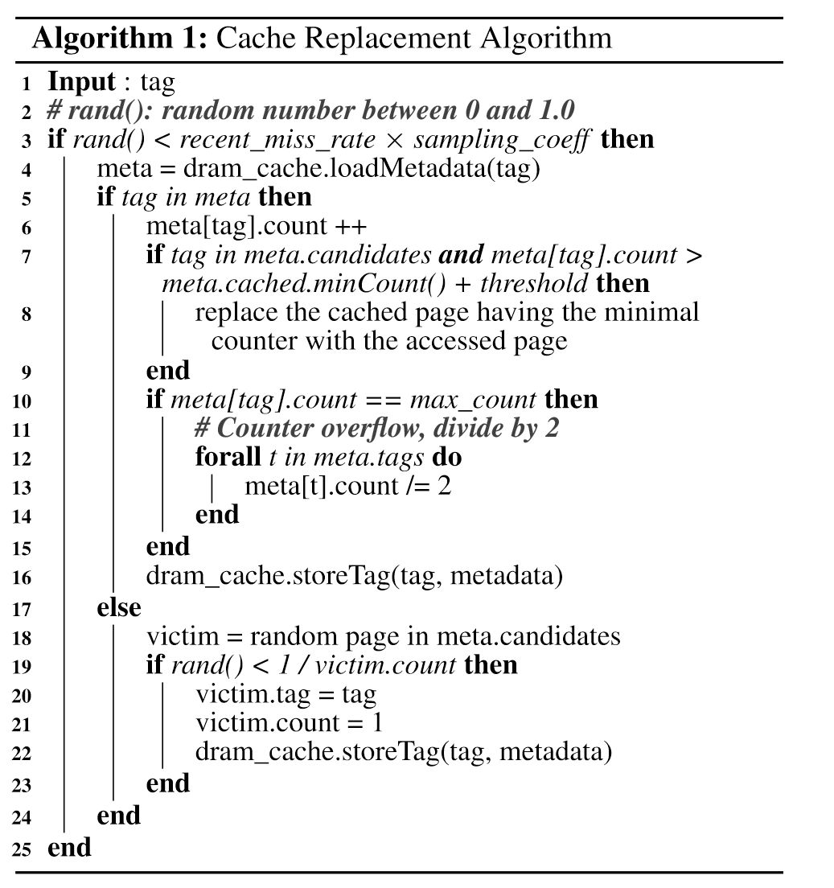
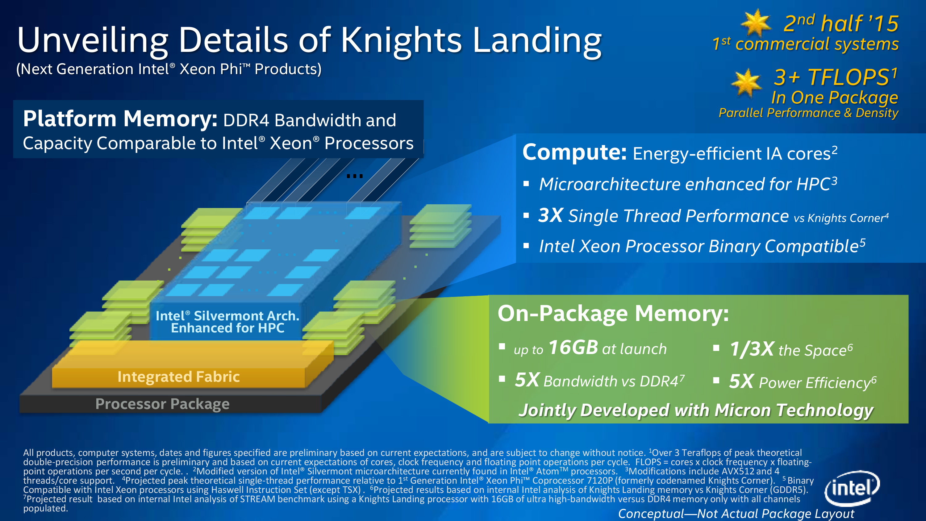
Banshee:

Slide 6
Banshee: Bandwidth-Efﬁcient DRAM Caching Via Software/Hardware Cooperation
Xiangyao Yu†, Christopher J. Hughes‡, Nadathur Satish‡, Onur Mutlu§, Srinivas Devadas†
† CSAIL, MIT, ‡ Intel Labs, § ETH Zurich
†{yxy, devadas}@mit.edu, ‡{christopher.j.hughes, nadathur.rajagopalan.satish}@intel.com, §onur.mutlu@inf.ethz.ch

Slide 7
Presentation Goals
Overview memory architecture and DRAM cache
Explain the HAWT NEW Banshee
Know about new developments
Rest assured that my money in chip manufacturing stocks will grow
$.$
Understand mechanisms supporting ML
Incite curiosity
Invite into computer architecture
So I can do ML and make money
Get an A

Slide 8
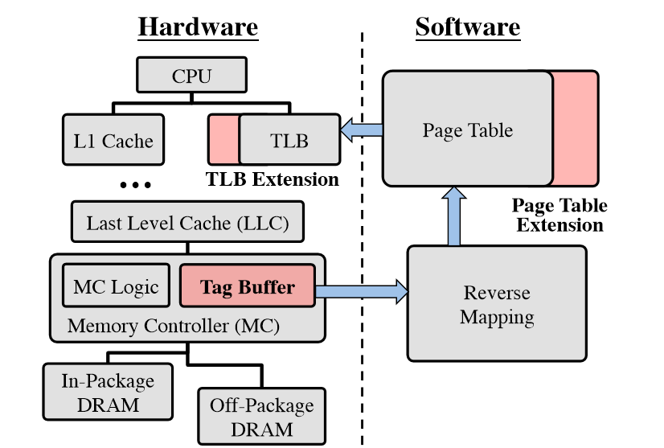
Memory Architecture (Cache and stuff)
TLB: Virtual => Physical
Page Table: TLB’s backing
(stored in main memory)
L1 to LLC cache DRAM
MC: Manages DRAM access
DRAM Cache: higher bandwidth
Read CS33 textbook for more

Slide 9
In-package DRAM
Built together with the processor and SOC
Higher bandwidth
Same latency

Slide 11
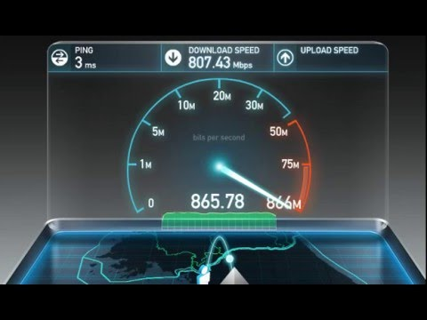

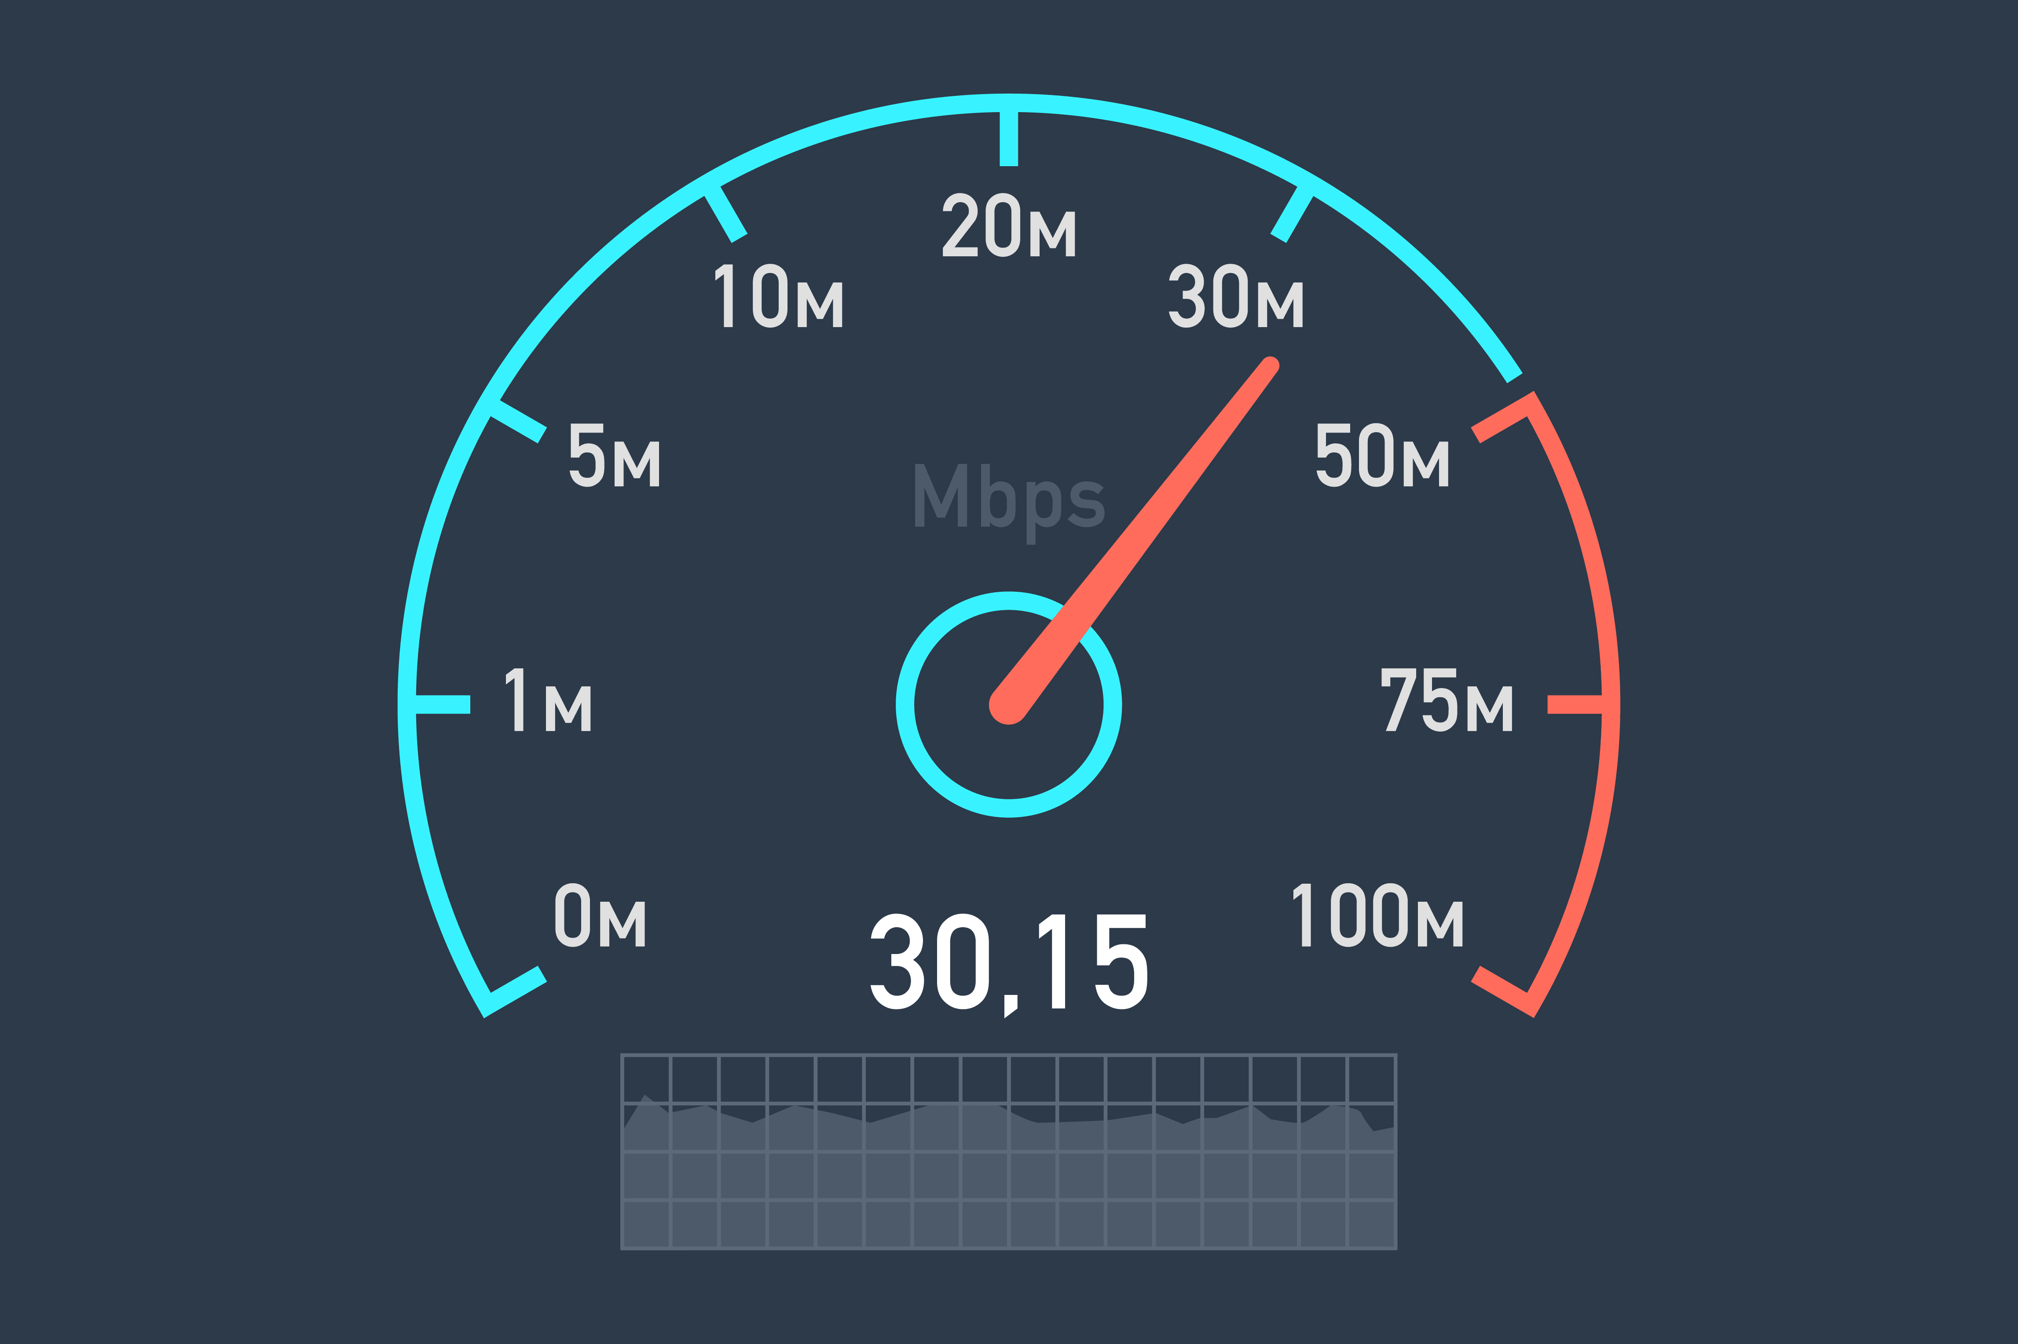
Why Banshee
Bandwidth bound modern applications
Graph and Machine Learning algorithms, Sparse Lin. Alg. HPC Code
Need Caching because expensive
Leverages ~4x bandwidth boost of in-package RAM
From Intel’s Knights Landing, AMD’s Fiji, Nvidia’s Pascal
Not latency-focused cache policy, but bandwidth-focused
Large Pages support

Slide 12
How Banshee
Software and Hardware
TLB/PTE Extension
Tag Buffer
Coherence
Sampling-based counter
Meta-data in DRAM cache
Frequency-based replacement

Slide 13
Architecture melding Hardware and Software
Just Hardware:
Quickly adaptive to changing program behavior
Dumb ‘algorithm’ (replace every time)
Just Software:
Smart at predicting what data to cache
Memory write time overhead so runs only every so often
Banshee:
Hardware tag buffer; lazy TLB coherence protocol; tracks miss rate
If buffer filled, consult software for how to replace

Slide 14
Algorithm
Decide whether to sample
Check if in metadata
Increment count
If candidate, check if above threshold
Check overflow
Decide whether to add as candidate

Slide 15
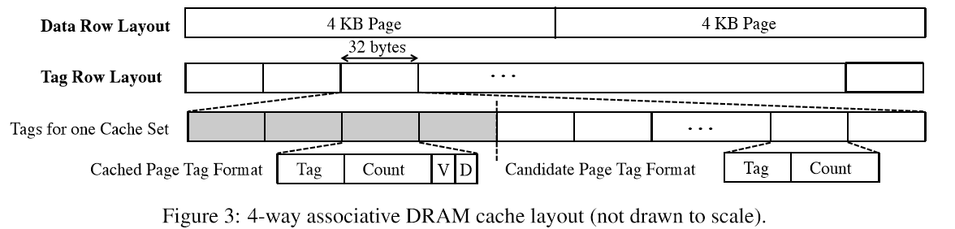
DRAM Cache

Slide 16
PTE and TLB Extension bits
Physical address are same for in and off package RAM
Address consistency issue => on-chip cache scrubbing
Cached bit: In-package?
Way bit: Where in package?
Overhead: 4-way associative = 2 way bits + 1 cached bit = 3 bits
4% for TLB
0% for PTE (since it has unused bits)

Slide 17
Tag buffer
Physical address as tag
Cached bit
Way bit
Valid bit
Remap bit

Slide 18
Speed
Over 3x faster with page rank program than no cache
Faster than only in-package RAM (LOL?)
Because both in and off package = more throughput
VS. Competing algorithms/architecture
68.9% speedup over Unison Cache
26.1% over TDC
15.0% over Alloy Cache

Slide 19
Links
MIT News article: http://news.mit.edu/2017/new-high-capacity-data-caches-more-efficient-1023
Paper: https://arxiv.org/abs/1704.02677
Pics: AncientPages.com, Intel, speedtest.net, LinkedIn

